Slide 1
Supporting NHS-R Developing an analytically powerful NHS

Slide 2
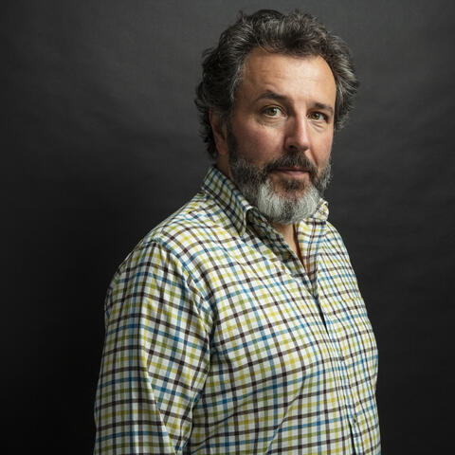
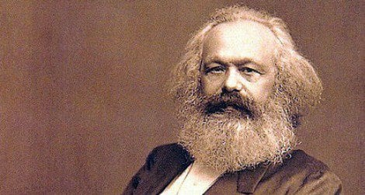
Peter Spilsbury Director, Strategy Unit

Slide 3
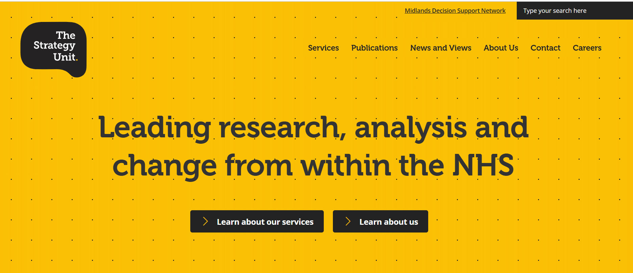
The Strategy Unit is a specialist NHS team.
Our proposition is simple:
better evidence, better decisions, better outcomes

Slide 4
The Strategy Unit is the new home for the NHS-R Community
Employ and develop a core team to help bring the community alive ….because we believe in it and what it is doing and can do for improving NHS ( and care) analysis
Raise profile and help the NHS-R community to influence policy

Slide 5
The Strategy Unit is the new home for the NHS-R Community
Raise funds!!
Health Foundation YES – thanks again for your leadership and vision
NHSE/I ???? Discussions in progress
Others……. ?

Slide 6
The Midlands Decision Support Network
https://www.midlandsdecisionsupport.nhs.uk/

Slide 7
The challenge…
11 ICSs in the Midlands region + NHSE/I
How do we support systems to make high-quality strategic decisions?
e.g. drawing on insight from analysis, accessing knowledge/evidence, translating these into action
How do we support each ICS to become a learning system?
e.g. routinely evaluating decisions, actively collaborating with other systems
How do we build the capacity, capability and culture needed to make this happen?
Notes:
DC

Slide 8
Decision Support Units…
E.g.
Black Country & West Birmingham
Decision Support Unit
Each ICS brings together a team, a ‘Decision Support Unit’ (DSU) or Intelligence Function
Focused on supporting the key strategic decisions faced by each system
A cross-system, collective endeavour… not top down!
Led by a chief analyst, multidisciplinary
Each DSU is part of a wider network across the region…
NHSE/I Midlands
BSOL
C&W
Derbyshire
H&W
LLR
Lincs
Northants
Notts
STW
SSOT
BCWB
…maximising opportunities for sharing, learning and collaboration
Sharing ideas
Sharing resources
Working on shared problems
Notes:
DC

Slide 9
Decision Support Units…
E.g.
Black Country & West Birmingham
Decision Support Unit
Each ICS brings together a team, a ‘Decision Support Unit’ (DSU)
Each DSU is part of a wider network across the region…
Each DSU is part of a wider network across the region…
NHSE/I Midlands
BSOL
C&W
Derbyshire
H&W
LLR
Lincs
Northants
Notts
STW
SSOT
BCWB
The network is supported by a ’Development Centre’
Provided by the Strategy Unit, funded by pooled subscriptions.
Notes:
DC

Slide 10
The Development Centre is supporting the ongoing development of the network…
Regional analytical programme
3+ analytical projects per year
shared innovation projects eg allocative efficiency; SD
knowledge mobilisation and application of findings
Education & development offer
Targeted development programmes
Large scale open events
educational seminar series
Active knowledge exchange
professional networks
guidance and tools
regional knowledge library
+ e.g. provision of highly specialist analysis, programme of R&D for new methods etc, building partnerships at local/national level, seeking additional investment in the region
Notes:
DC

Slide 11
I
Improving decision-making practice
eg Decision Quality for leaders; thinking tools for decision making; training in analytical concepts for leaders
Developing analytical leaders
Leadership for Analysts programme; communication skills/arguing with numbers; data visualisation; presentation/facilitation skills
Moving beyond the numbers
Approaches to evidence review; cognitive biases; core skills in knowledge mobilisation; fundamentals of evaluation
Strengthening analytical capability
Advanced PHM analytics; operational research methods; machine learning; time-series forecasting; open-source tools; reproducible analytical pipelines (RAP)

Slide 12
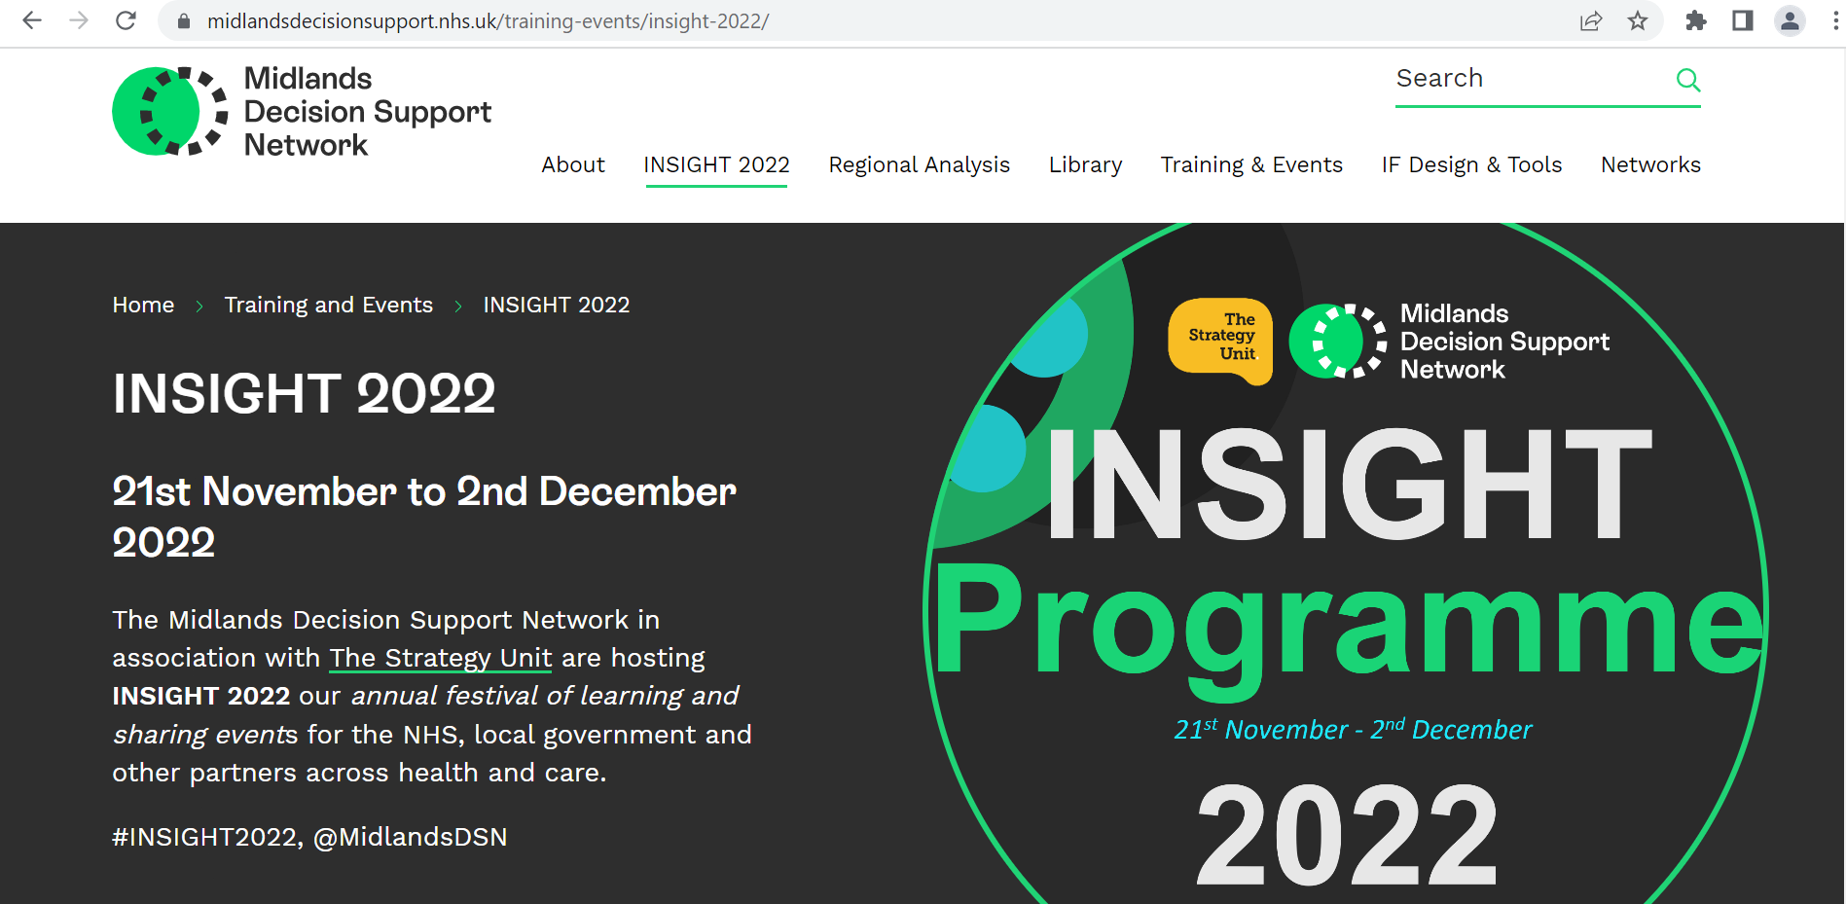
Nigel Edwards; Prof Eric Wolstenholme; Dr Julian Huppert; Dr Bola Owolabi; Professor Angie Hobbs; Sarah-Jane Marsh; Sir David Dalton; Sir David Nicholson; Sarah Scobie, Charles Tallack and Steven Wyatt; Dennis Sherwood… and many more. Free for all ……please join; you will be very welcome!

Slide 13
Analytical professionalisation and national initiatives; Goldacre Report
MDSN and growing DSN family
NHS-R and family

Slide 14
Our next (ad)venture…..
The first National NHS Analysis Conference/Festival (name tbc) ,2023/4
Celebrating NHS (+pubic sector partners) analysis for improvement ( ‘insight to action’)
Funded by the NHS to be free for NHS participants
2 days in the Midlands; 500+ participants; UK wide
Purposefully linked with NHS-R; APHA etc …….maybe in the future an NHS analysis and data science week will emerge!
THE annual event for NHS analysts and analytical enthusiasts!

Slide 15
Thanks for coming! Stay involved.
www.strategyunitwm.nhs.uk
www.midlandsdecisionsupport.nhs.uk

